Slide 1
Sogyo IP

Slide 2
Plans Initially & later on
Tekst-based --> picture-based
Local --> Heroku deployment
One inventory system for usage + display -->
Separate systems for usage / display

Slide 3
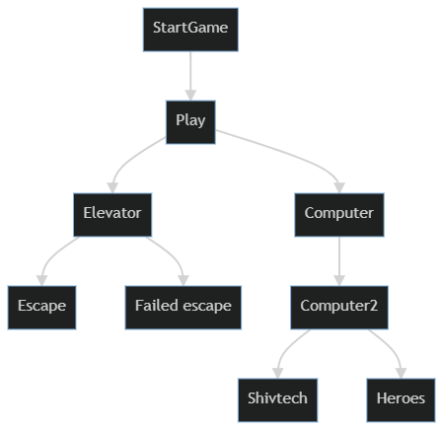
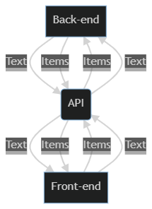
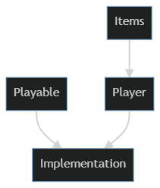
Architecture Ft. zeemeermin

Slide 4
Goals Technical & personal
Mental overview of model
Connections between files on the same end
Connections between front- and back-end
Priorities

Slide 5
Showcase!!
http://escape-room-the-lair.herokuapp.com/

